Slide 1
Multiple Linear Regression Modelling Case Study Rinny Kapoor

Slide 2
OVERVIEW
Predicting academic performance of an elementary school using attributes like class size, enrollment, poverty, parent education, student performance, teachers credentials from 400 elementary schools from the California Department of Education's API 2000 dataset.

Slide 3
Variables used for building dataset
S.No. Variable Name Label
acs_46 class size 4-6
acs_k3 class size k-3
api00 Academic Performance Indicator 2000
api99 Academic Performance Indicator 1999
avg_ed Average number of Years of High school parent education
col_grad % of Parents who are college grad
dnum district number
ell % of Students who are English language learners
emer % of part Time Teachers
enroll Number of students
full % of full Time Teachers
grad_sch % of Parents who are attended grad school
growth growth 1999 to 2000
hsg % of Parents who are high school graduate
mealcat free meals in 3 categories
Smeals % of Students who opt for free meals
mobility Dropout Rate
not_hsg % of Parents who are not high school graduate
snum school number
some_col % of Parents who are attended some college
yr_rnd year round school – School open through the year or not
Notes:
Variables marked in red are not used in modeling and variable api00 marked in purple is dependent variable.

Slide 4
Feature Creation
We will take together all variables together which are mutually exclusive to each other and let it name as S.
S=NOT_HSG+HSG+SOME_COL+COL_GRAD+GRAD_SCH
Now let’s look at the frequency table of S.
S Frequency
0 19
98 2
99 68
100 216
101 92
102 3

Slide 5
Missing Values in data
S.No. Variable N N Miss Mean
snum 400 0 2866.81
dnum 400 0 457.735
api00 400 0 647.6255
api99 400 0 610.2125
growth 400 0 37.41
Meals 315 85 71.9936508
ell 400 0 31.4525
yr_rnd 400 0 0
mobility 399 1 18.2531328
acs_k3 398 2 18.5477387
acs_46 397 3 29.6851385
not_hsg 400 0 21.2525
hsg parent 400 0 26.015
some_col 400 0 19.7125
col_grad 400 0 19.6975
grad_sch 400 0 8.6375
avg_ed 381 19 2.6684777
full 400 0 66.0568
emer 400 0 12.6575
Enroll 400 0 483.465
mealcat 400 0 2.015
Notes:
Variables marked in red shows that they have missing values

Slide 6
Anomalies in the data
1.acs_k3 - Class Size k-3
percentiles: 0% 10% 25% 50% 75% 90% 100%
-21 17 18 19 20 21 25
The class size ranges from -21 to 25 and it seems odd for a class size to be -21because class size cannot be negative. It seems that either some of class sizes got negative or some negative sign get typed in front of them by mistake. For this we have to check if they come from same district number. Indeed they came from same district number 140.

Slide 7
Anomalies in the data continued……
2. full -pct full credential
percentiles: 0% 10% 25% 50% 75% 90%
.42 67 .95 87 97 100
It appeared as some percentages has been entered as proportions i.e. 42 entered as 0.42 and 95 entered as 0.95. For this we have to check if they come from same district number. Indeed they came from same district number 401.

Slide 8
Data Treatment
1.Avg_ED-Average Education
As we can see that there are 19 missing values in average education and by looking at the table s, we can conclude that these missing values to be replaced with 0.
2.Acs_K3-Class Size K-3
Since class size is negative so we can correct it by taking absolute value of all negative values.

Slide 9
Data Treatment Continued……
3.Full-% of full time teachers
Since some values in full time teachers category are in proportion. So we need to correct them by multiplying it by 100.

Slide 10
Treatment of missing values
Since the missing values in ACS_K3,ACS_46,MOBILITY are less so we replace the missing values with their mean. In Meals, the no. of missing values are high, so we have divided the meals according to the meal category and taken the mean accordingly.
IF ACS_K3 = . THEN ACS_K3 =19.1608040;
IF ACS_46 = . THEN ACS_46 =29.6851385;
IF MOBILITY = . THEN MOBILITY =18.2531328;
IF MEALCAT = 1 AND MEALS = . THEN
MEALS = 28.36;
5. IF MEALCAT = 2 AND MEALS = . THEN MEALS = 66.0468750
Notes:
Since our data is cleaned so now we proceed further to check interdependence between continuous and categorical variables.

Slide 11
Correlation of Dependent variable api00 with the continuous and categorical variables
1.Meals
The relation between api00 and meals is statistically significant.
The coefficient is negative which indicates that if free meals increases, academic performance decreases because people who does not have enough resources will go to school where free meal are offered, so it will automatically decreases academic performance in comparison to other schools where no free meal is offered.

Slide 12
Correlation of Dependent variable api00 with the continuous and categorical variables continued…….
2.Mobility
The relation between api00 and mobility is statistically significant. The coefficient is negative which indicates if student migrate, then academic performance will be low.
3.ACS_46
The relation between api00 and acs_46 is statistically significant. The coefficient is positive which indicates that if average class size increases, the academic performance increases because average class size for 4 to 6 can be a representation that in higher classes with a larger class size the students are able to learn well.

Slide 13
Correlation of Dependent variable api00 with the continuous and categorical variables continued…….
5.Yr_rnd
The relation between api00 and yr_rnd is statistically significant.
The coefficient is negative which indicates if school is open year round then academic performance is low because if full time teachers has to come everyday on a school, they will not join the school so academic performance will be low.

Slide 14
Correlation of Dependent variable api00 with the continuous and categorical variables continued……
6.Mealcat
The relation between api00 and mealcat is
statistically significant. The coefficient is negative which indicates that as meal category is increasing from 1 to 3,api00 score is decreasing.
7.Enroll
The relation between api00 and enroll is statistically significant. The coefficient is negative which indicates that more number of students in class, lower will be the academic performance.

Slide 15
Correlation of Dependent variable api00 with the continuous and categorical variables continued…….
8.Avg_Ed
The relation between api00 and avg_ed is
statistically significant. The coefficient is positive which indicates that if average education increases, the academic performance increases.
9.Emer
The relation between api00 and emer is
statistically significant. The coefficient is negative which indicates that if teachers will be part time they will not come everyday and it will affect the academic performance of the students.

Slide 16
Correlation of Dependent variable api00 with the continuous and categorical variables continued…….
10.Full
The relation between api00 and full is statistically significant. The coefficient is positive which indicates that if teachers are full time they will come regularly which automatically increases the academic performance.
11.Grad_sch
The relation between api00 and grad_sch is statistically significant. The coefficient is positive which indicates that if the parents are high school graduate they will concentrate more on the studies of their child and will able to guide them more, so the academic performance will increase.

Slide 17
Correlation of Dependent variable api00 with the continuous and categorical variables continued…….
12.not_hsg
The relation between api00and not_hsg is statistically significant. The coefficient is negative which indicates that if the parents are not high school graduate, the academic performance of their children will go down.
13.Hsg
The relation between api00and hsg is statistically significant. The coefficient is negative which indicates that if the parents are high school graduate, the academic performance of their children will go down.

Slide 18
Correlation of Dependent variable api00 with the continuous and categorical variables continued…….
14.Some_col
The relation between api00and some_col is statistically significant. The coefficient is positive which indicates that if the parents attended some college, the academic performance of their children will increase.
15.col_grad
The relation between api00and col_grad is statistically significant. The coefficient is positive which indicates that if the parents are college graduate, the academic performance of their children will increase.

Slide 19
Correlation of Dependent variable api00 with the continuous and categorical variables continued…….
16.Ell
The relation between api00and ell is statistically significant.
The coefficient is negative which indicates that if the students who are English language learners, then their academic performance will go down because it represents that more students with low economic background are taking admission hence affecting performance.

Slide 20
Regression Equation
Api00=459.71-2.89Ell-3.10Mobility+3.68Acs_46+3.37Grad_Sch+2.33Full
Interpretations:
For unit increase in Ell, api00 index decreases by 2.89 because it represents that more students with low economic background are taking admission hence affecting performance. So my recommendation to schools is that they should change their selection criteria and do screening test of all the subjects so that their academic performance does not get affected.
For unit increase in mobility, api00 index decreases by 2.10 because if more student will migrate it will affect the overall performance of schools as less student will appear for exam. So schools should concentrate on stopping the migration of students.

Slide 21
Interpretations Continued………
For unit increase in acs_46,api00 index increases by 3.68 because students in higher classes are able to learn well by their own and do not require much attention, thereby increases the academic performance.
For unit increase in grad_sch, api00 index increases by 3.37 because the Students whose parents are high school graduate they will concentrate more on the studies of their child and will able to guide them more, so the academic performance will increase.
For unit increase in full,api00 index increases by 2.33 because if teachers are full time they will come regularly which automatically increases the academic performance

Slide 22
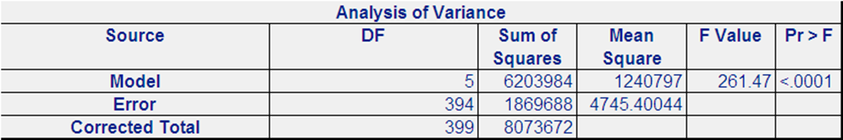
Overall Significance of the model
F-Value:261.47
P-value<0.0001
High F-value and significant value of P jointly explain Api00 at 99.99% of confidence interval.

Slide 23

Goodness of fit of the model
R- Square:76.84%
Adjusted R-Square:76.55%
As five explanatory variables ell,mobility,acs_46,grad_sch and full total explain 76.84% of variation in Api00 index. Also there is small difference in R-Square and Adjusted R-Square which there is no overfitting of the model.

Slide 24
Prediction Accuracy of model
MAPE:8.91
The mean absolute percentage error is 8.91 which shows on average forecast is off by 8.91%.

Slide 25
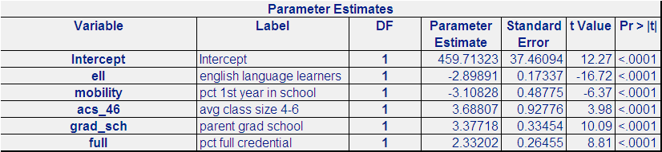
Multicollinearity
All the variables have VIF<1.7 and P-value<0.0001,which indicates that there is no correlation between all the variables and all five variable are statistically significant at 99.99% of CL.

Slide 26

Check for constant variance
Since P-Value=0.0024>0.0001,so null hypothesis that variance is constant. Hence model satisfies the homoscedacity.

Slide 27
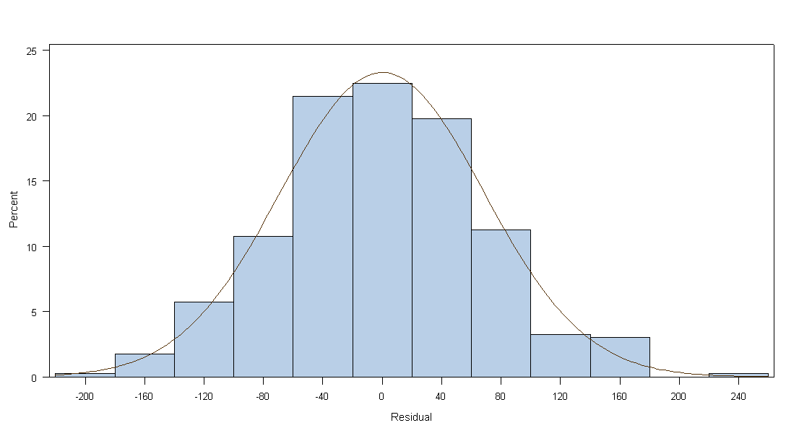
Normality
The following graph shows that our model follow the normality.

Slide 28
Thank You

